Slide 1


WasteWise
NEPAL
Reduce waste, increase profit , smart inventory management for nepali retailers.

Slide 2


Table of Content
1
About US
4
Features
2
Problems
5
DEMO
3
Objectives
6
End

Slide 3
ABOUT Us
Our mission is to reduce product waste, prevent financial loss, and improve inventory accuracy.
We created this solution because many stores still monitor expiry dates manually, leading to unnoticed losses.
With our simple and smart system, businesses can stay informed and act on time, ensuring better efficiency and customer safety.

Slide 4
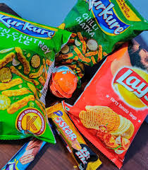
Problems
Too much expired or unsold stock increasing losses
Waste product
Reserve old product instead of new one not knowing data of product

Slide 5
Objectives
Reduce product waste
Strengthen Retailer-Supplier Coordination
1.
2.
3.
Nepali Market Friendly Design
Smart Inventory Practices
Real Time Data Monitoring
4.
5.
6.
Empower Local Business With Technology

Slide 6
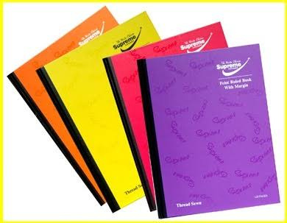
Features
Helps shops track expiry dates and get early notifications.
Nepali Market- Friendly Design
Recycling, discounting and donation service for near expiry products.
Separate login accounts for retailers to access our services.

Slide 7
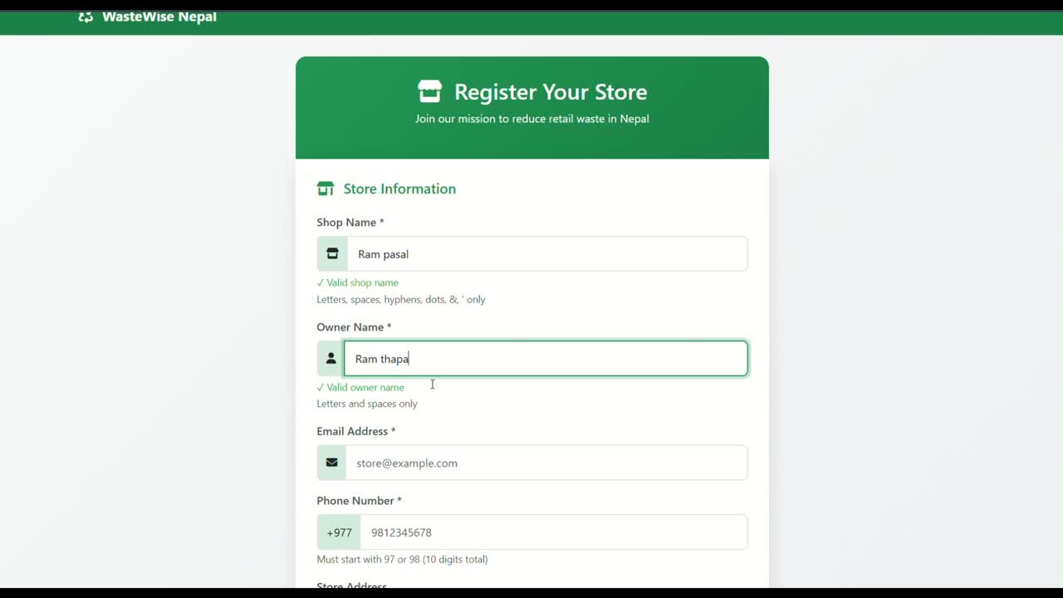

Slide 8



Our Team
Diya Sharma
Aayusa Neupane
Pooja Tharu

Slide 9

“We welcome your questions and feedback.”

